Slide 1
NETWORKING
Computer networking refers to interconnected computing devices that can exchange data and share resources with each other.

Slide 2
REQUIREMENTS
Hardware requirements
Ethernet card/ LAN card / Interface/ Network Adopter / NIC
Medium ( wireless / wired )
Network Devices [ HUB / Switch / Router ]

Slide 3
Logical Terms
Mac Address / Hardware Address / physical Address
IP Address [ Public, Private, Static. Dynamic, Real, Virtual ]
Source Address,
Destination Address
Network Address,
Broadcast Address
Ports
Sockets

Slide 4
IP Address - IP address stands for “Internet Protocol address.” The Internet Protocol is a set of rules for communication over the internet
Mac Address – MAC address is the physical address, which uniquely identifies each device on a given network. It’s persistent.

Slide 5
IP Address
IPV6
IPv4
( 128 bit )
(32-bit)

Slide 6
IPv4
Bits are defined in 4 octets.
8.8.8.8.
00000000.00000000.0000000.00000000
11111111.11111111.11111111.11111111
0.0.0.0.
255.255.255.255

Slide 7
CLASSES of IPv4
Class A : 0 – 126
Class B : 128 – 191
Class C : 192 – 224
Class D : 225 – 239
Class E : 240 – 255
Class D and Class E are reserved for research and multicasting.
IP range of 127 is known as a loopback address

Slide 8
Class A : N.H.H.H
Class B : N.N.H.H
Class C : N.N.N.H
Example : Class C – 192.168.72.41
192.168.72.0 = Network Address
192.168.194.255 = Broadcast Address

Slide 9
SUBNETTing
Logical distribution of the Network in various logical parts are known as subnetting
Subnet = Sub Networks
When Subnetting is performed, something known as a subnet mask comes in existence.
Class A = 255.0.0.0
Class B = 255.255.0.0
Class C = 255.255.255.0

Slide 10


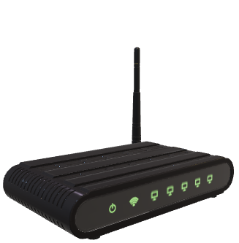
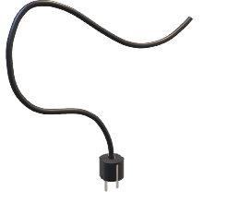



Slide 11
Static IP
Dynamic IP
Real IP
Virtual IP
Ports
Sockets

Slide 12
Server-Client Models
Server serves services to clients
Clients are the hosts which are using services provided by the server
Requests sent by clients to any server are in the form of sockets.
Sockets are the combination of IP address and ports
Sockets = IP address:ports

Slide 13
PORTS
Ports can be understandable as the address of services running over the server.
Requests sent by clients over the server where multiple services are served can be identified by the ports they are listening on.
Total number of ports we are having is 65535.
Out of the above ports few ports are reserves for specific services.

Slide 14
DNS listens at 53 port
Webserver at 80 and 443
Mail server at 25
Database server at 3306
SSH server at 22

Slide 15
Network devices
Requirement of the network device to communicate
Source address
Destination address
Source Mac Address
Destination Mac Address

Slide 16
Network devices we are going to discuss
HUB
Switch
[ communication between devices having same network range ]
Router
[ communication between different networks ]
[ provide route to packages ]

Slide 17
TCp/iP models
The TCP/IP model is a four-layer model that divides network communications into four distinct categories or layers :
Application layer
Transport layer
Network layer
Data-link / Physical layer

Slide 18
Naming convention of ethernet card
ethN = eth1 eth2 eth3
enoN = eno1 eno2 eno3
ensN = ens100 ens223
wlanN = wlan0 wlan1 wlan2
wwn

Slide 19
Multiple ethernet cards can be assigned to one system.
Ip address assigned to the ethernet card can be manual and automatic by the DHCP server. such configuration depends on connections.
Connections are collections of settings.
ping command can be used to check the connection with the server or another host.
ICMP protocol is responsible to send packets in order to check connectivity.

Slide 20
Connection established between servers through ping command is actually performed by using IP addresses only.
Ping command finds such names in hosts file of your system (/etc/hosts).
If no entry is found in /etc/hosts then this search transferd to /etc/resolv.conf file which is having entry of the name server.

Slide 21
There is a command nslookup, which is used to check ip address of any website or name server.
netstat –tulpn command is used to check open ports of your system.
ss –tulpn can be used for the same purpose.
hostnamectl set-hostname admin can be used to set hostname for system.

Slide 22
IP address configuration
Connection = collection of settings
nmcli is a command can be used to configure various network settings in your system.
nmcli stands for network manager command line.
nmcli device status is used to check connected devices in your system.
nmcli con show command can be used check connections of your system.

Slide 23
Configure IP address through command line
nmcli con add con-name grras type ethernet ifname ens192 ipv4.method auto this command can be used to add connection through command line.
nmcli con down grras
nmcli con up grras
nmcli device status
nmcli con mod grras ipv4.addresses 172.34.56.78/8 ipv4.gateway 192.34.53.123 ipv4.dns 8.8.8.8 ipv4.method manual. Can be used to set ip address manually through command line.

